Slide 1
RECIPE DATA CLEANING

Slide 2
Feeding America Data Analysis (1961–2013) Exploring U.S. Food Trends Across Major Historical Periods
Research Questions:
Did meat consumption change across years?
Has sugar availability increased over time?
Did plant-based foods increase during health-conscious years?

Slide 3
Major Historical Events (1961–2013)
The Rise of Fast Food (1950s–present) Massive expansion and normalization of convenience-based eating.
Increased Awareness of Health and Nutrition (1970s–present) Greater concern about heart disease, obesity, and dietary guidelines.
The “Foodie” Movement & Celebrity Chefs (1980s–present) Popularized gourmet cuisine and diverse cooking styles.
Environmental & Ethical Concerns (1990s–present) Growth of organic, sustainable, and locally sourced foods.
Technological Advancements in Food Production Increased food variety, availability, and reduced cost year-round.
Notes:
Data analytics, on the other hand, refers to the process and practice of analyzing data to answer questions, extract insights, and identify trends

Slide 4
About our Dataset (FAO.csv)
The dataset contains:
Food and agriculture data
Multiple countries (1961–2013)
Production, supply, trade, and utilization data
Units such as kcal/capita/day and thousand tons
From this dataset, we can analyze:
Food supply trends
Dietary shifts (meat, sugar, plant-based foods)
Production growth
Trade dependency
Agricultural productivity
Developed vs developing comparisons
For this project, we focused on United States data only.
Notes:
Data analytics, on the other hand, refers to the process and practice of analyzing data to answer questions, extract insights, and identify trends

Slide 5
Recipe: Data Cleaning Steps
Step 1: Filter to United States
Removed all other countries.
Step 3: Categorize Foods
Created grouped categories:
Meat
Sugar & Sweeteners
Plant-Based Foods
Step 2: Convert from Wide to Long Format
Original structure: Y1961, Y1962, … Y2013
Converted into:
Year column
Value column
This allowed proper time-series analysis.
Step 4: Export Clean File
Saved as: usa_feeding_categorized food.cs
Notes:
Data analytics, on the other hand, refers to the process and practice of analyzing data to answer questions, extract insights, and identify trends

Slide 6
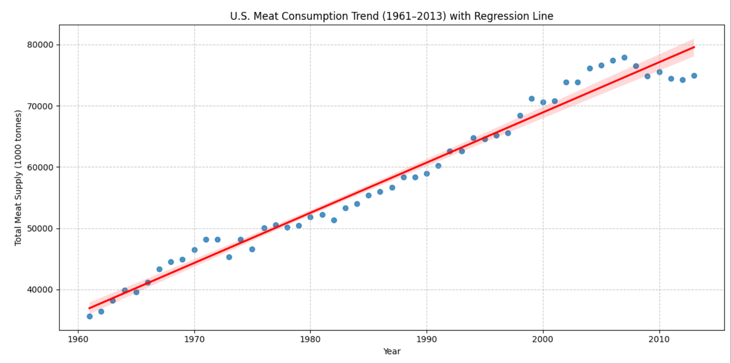
Q1: Did Meat Consumption Change Across Years?
Method:
Aggregated total U.S. meat supply (1961–2013)
Conducted time-trend analysis
Visualized yearly changes
Conclusion:
U.S. meat consumption for direct human intake has experienced a substantial and statistically undeniable increase between 1961 and 2013.
This suggests:
Strong long-term growth
Influence of fast food expansion
Increased industrial meat production
Notes:
Data analytics, on the other hand, refers to the process and practice of analyzing data to answer questions, extract insights, and identify trends

Slide 7
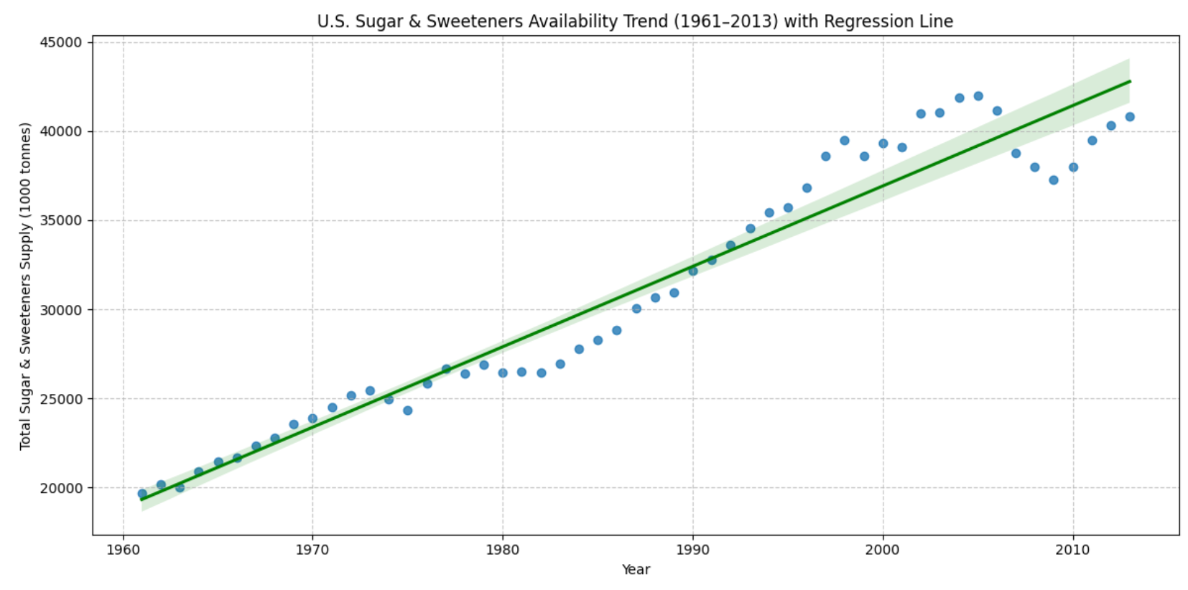
Q2: Has Sugar Availability Increased Over Time?
Method:
Aggregated sugar & sweetener availability
Ran time-series trend analysis
Conclusion:
The analysis clearly demonstrates a highly significant and consistent increase in U.S. sugar and sweeteners availability from 1961 to 2013, with an average annual increase of 450.76 thousand tons
This aligns with:
Processed food growth
Rise of sugary beverages
Industrial food expansion
Notes:
Data analytics, on the other hand, refers to the process and practice of analyzing data to answer questions, extract insights, and identify trends

Slide 8
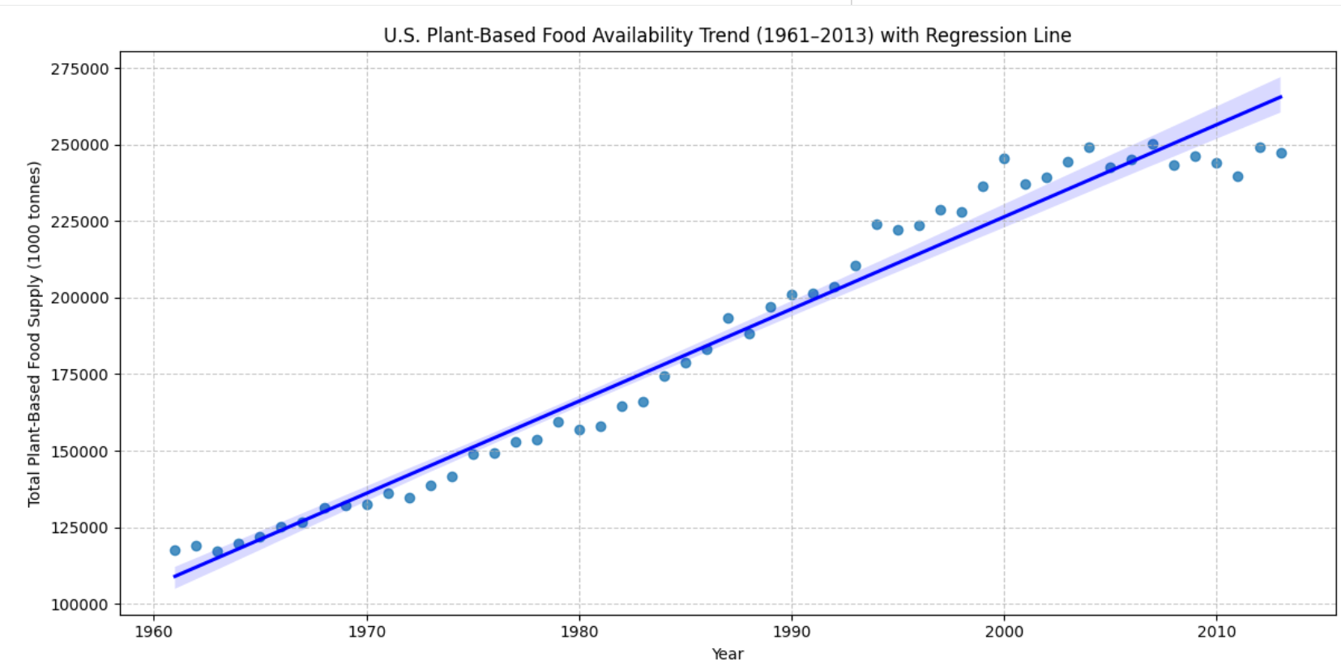
Q3: Did Plant-Based Foods Increase During Health-Conscious Years?
Method:
Aggregated plant-based food categories
Visualized trend from 1961–2013
Conclusion:
The visualization clearly demonstrates a highly significant and consistent increase in U.S. plant-based food availability from 1961 to 2013, with an average annual increase of 3011.29 thousand tons.
This suggests:
Growing health awareness
Rise in organic and sustainable movements
Increased demand for plant-based options
Notes:
Data analytics, on the other hand, refers to the process and practice of analyzing data to answer questions, extract insights, and identify trends

Slide 9
Overall Findings
Across 1961–2013:
✅ Meat availability increased significantly
✅ Sugar availability increased significantly
✅ Plant-based food availability increased significantly
This indicates:
Overall food supply expansion
Industrialization of food systems
Simultaneous growth in both processed foods and health-conscious alternatives
Notes:
Data analytics, on the other hand, refers to the process and practice of analyzing data to answer questions, extract insights, and identify trends

Slide 10
CONCLUSION
U.S. food availability expanded dramatically over 52 years.
Historical, economic, and cultural shifts influenced dietary patterns.
Both convenience-driven and health-conscious trends grew simultaneously.
Notes:
Data analytics, on the other hand, refers to the process and practice of analyzing data to answer questions, extract insights, and identify trends

